Slide 1
Gender and Context Choice Influence on Student Performance and Attitude
Samuel R. Wheeler & Margaret R. Blanchard
North Carolina State University
AAPT 2017 National Conference
Cincinnati, OH

Slide 2
Literature Review: the problem
Differential enrollment of females in STEM majors, can be traced back to before students go to college (Heilbronner, 2013)
Most dramatic gender disparities in college engineering and physics programs - believed to result from female students’ low enrollment in high school physics courses (Blickenstaff, 2005)
36% of undergraduate STEM degrees and 19% of undergraduate physics degrees were awarded to women in 2012 (American Physical Society, 2012).
Discrepancies in teacher’s understanding of how to connect physics to female students (Mulhall, 2012)
Cultural aspects for why women are less likely to go into STEM (McNeely & Vlaicu, 2010)

Slide 3
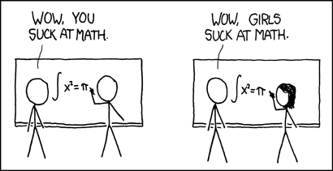
Literature Review: what can be done?
Specifically designed physics curricula around female student interests has not been fully explored (McCullough, 2004)
Integrating medical and biological fields into the traditional physics curriculum can increase female students’ interest in physics (Gibson, Cook, & Newing, 2006)
Research indicates that the gender gap in physics is due to issues of motivation, interest, and other affective qualities (National Research Council, 2013).
Student choice during learning can play a prominent role in a child’s learning process (Alozie, Moje, & Krajcik, 2010)
H
http://blog.physicsworld.com/2015/06/10/success-failure-and-women-in-physics/

Slide 4
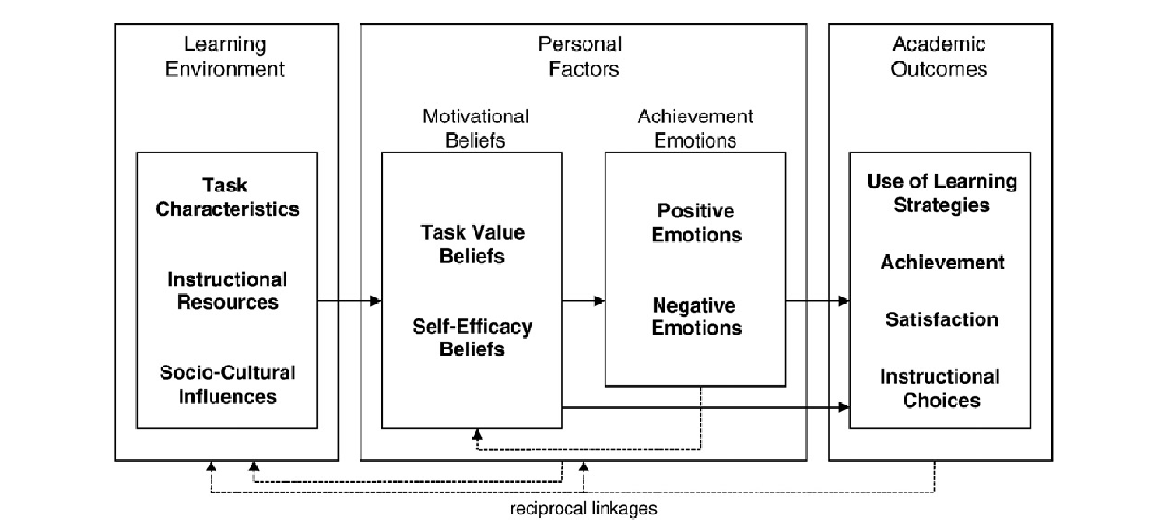
Theoretical Framework
Social-cognitive model of academic motivation and emotion (adapted from Artino, 2010).
Notes:
The theoretical framework used for this study applies a social-cognitive foundation to connect the influence of student choice, motivation, achievement emotions, satisfaction, and academic achievement together (Artino Jr, 2010). Artino used this framework to investigate the factors that influenced students’ decisions to enroll in online courses.

Slide 5
Research question & methods
What are students’ attitudes toward, beliefs about, and interest in physics, do these change, and if so, what factors account for these changes?
METHODS
Part of a larger explanatory mixed-methods investigation on the role of gender bias/stereotypes in female students’ interest in high school physics
Participants:
  8 teachers from 7 schools representing 5 U.S. states
  Teachers overwhelmingly used traditional examples in their instruction on Newton’s Laws
  71 high school juniors & seniors in honors/AP physics; 66% Male 33% Female; 60% white, 25% Asian, 15% other
Instruments:
  Pre/post Force Concept Inventory (FCI) to evaluate changes in physics conceptual understanding
  Pre/post Colorado Learning Attitudes about Science Survey (CLASS)-Physics to evaluate student interests/attitudes
  21 written and video analysis homework problems delivered via WebAssign-Newton’s Laws

Slide 6

Webassign Questions
21 different physics questions:
  15 written, 6 video analysis
3 contexts per question:
  traditional, sports, biology/medical
  Students were to choose 1 context of each question
Parameters:
  Students were given 5 submissions (chances) to get each problem correct
  Webassign automatically grades student response & gives immediate feedback
  Students had 4 weeks to complete

Slide 7
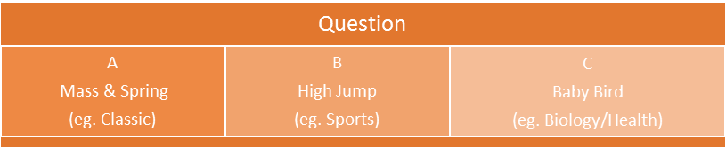
Student Choice
Primary question context (Biology/Traditional/Sports) chosen:
  For Female was biology
  For Male was traditional
Achievement:
  No difference between average scores overall
  But three questions (across 3 contexts) where males had higher average scores
57% of the students chose to do multiple contexts within a question
  1st All choices answered
  2nd Biology-sports combo answered
  3rd Traditional-sports combo answered
Notes:
Both males & females chose had the same pattern of responses for combos chosen
40 out of 70 participating students chose to do more than one context

Slide 8
Breakdown of Choices
Group | Number of Students | Traditional Contexts Chosen |  | Biology Contexts Chosen |  | Sports Contexts Chosen
 |  | Total | % | Total | % | Total | %
Female | 21 | 154 | 34.9 | 166 | 37.6 | 116 | 26.3
Male | 31 | 253 | 38.9 | 216 | 33.2 | 176 | 27.0
Female 1st Choice Combo | 11 | 83 | 32.9 | 100 | 39.7 | 67 | 26.6
Male 1st Choice Combo | 21 | 168 | 38.1 | 147 | 33.3 | 121 | 27.4
Female No Combo | 9 | 71 | 37.6 | 66 | 34.9 | 49 | 25.9
Male No Combo | 10 | 85 | 40.5 | 69 | 32.9 | 55 | 26.2
Breakdown by gender and context of question choices
(* fewer than 2% of all contexts were not answered)

Slide 9
Responses Analyzed by Choice
 | First Choice |  | Second Choice |  | Last Choice (for ‘All’ Category)
Gender | #correct | #submissions | #correct | #submissions | #correct | #submissions
Female | 0.851* | 2.11 | 0.405 | 2.30 | 0.333 | 2.89
Male | 0.695 | 3.22*** | 0.472 | 2.49 | 0.25 | 2.55
Average number of responses and submissions by gender.
Note. *p < .05. **p < .01. ***p < .001

Slide 10
Web Assign Question Response Rate by gender
Female had a higher response rate for 13 of 21 questions
Female had higher response rate for 4 of 6 video analysis questions and equal rate to males for 1 (more than 1 context chosen)
Female used more submissions than Male (statistically significant) on 4 questions, all others statistically equal
Notes:
Response rate found by #contexts within question/total number of responders in group-more than one context within a question

Slide 11
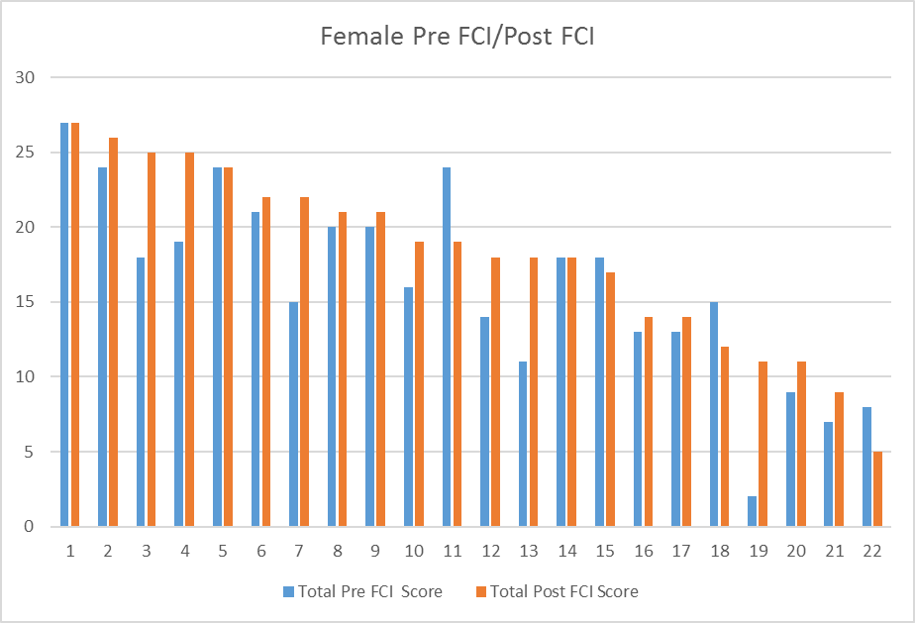
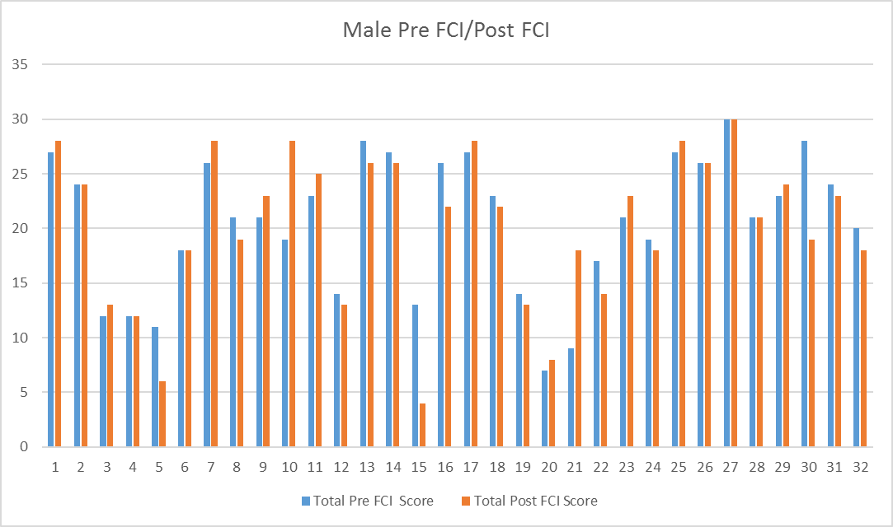
Findings:
Pre/post treatment FCI
68.2% of females improved their score; 13.6% no change; 18.2% decreased
37.5% of males improved their score;18.8% no change; 43.7% decreased
Pre Avg: Male 19.3 vs Female 15.4; p=0.0159
Post Avg: Male 20.15 vs Female 18.09; p=.1211 (no sig difference)
Notes:
Using two sample t-tests assuming unequal variances

Slide 12
Males Vs females on Pre CLASS
Males Higher in 6 CLASS Categories before treatment
Problem Solving Pre
  Q29In physics, mathematical formulas express meaningful relationships among measurable quantities. M 4.47 vs F 3.96 p=.0067
  Q37 I can usually figure out a way to solve physics problems. M 3.98 vs F 3.44 p=0.037
Problem Solving Confidence Pre
  Q37 I can usually figure out a way to solve physics problems. M 3.98 vs F 3.44 p=0.037
Problem Solving Sophistication Pre
  Q37 I can usually figure out a way to solve physics problems. M 3.98 vs F 3.44 p=0.037
Sense Making Pre
  Q42 When I solve a physics problem, I explicitly think about which physics ideas apply to the problem. M 4.06 vs F 3.6 p=0.0173
Conceptual Understanding Pre
  Q8 Knowledge in physics consists of many disconnected topics. M 4.063 vs F 3.44 p=0.0136
Applied Conceptual Understanding Pre
  Q8 Knowledge in physics consists of many disconnected topics. M 4.063 vs F 3.44 p=0.0136

Slide 13
Males vs females on Post CLASS
Males higher in only 3 categories after treatment
Personal Interest/Real World Connections Post
  Q16 I study physics to learn knowledge that will be useful in my life outside of school. M 3.905 vs F 3.353 p=0.0238
  Q33 Reasoning skills used to understand physics can be helpful to me in my everyday life M 4.476 vs F 4.0588 p=0.03019
Problem Solving BvG
  Q37 I can usually figure out a way to solve physics problems. M 4.047 vs F 3.647 p=0.0483
Problem Solving Confidence BvG
  Q37 I can usually figure out a way to solve physics problems. M 4.047 vs F 3.647 p=0.0483
Notes:
The only categories to hold over from pre were problem solving & problem solving confidence

Slide 14
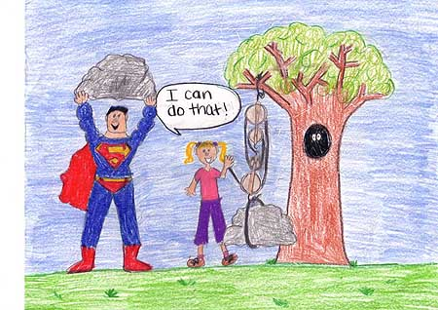
Class: Gains for female students
Problem Solving Sophistication & Applied Conceptual Understanding BvG
  Q25 If I want to apply a method used for solving one physics problem to another problem, the problems...Male 2.6667 vs Female 3.176 p=0.0450; paired two Sample for Means Pre-to-Post analysis
Sense Making
  Q42 When I solve a physics problem, I explicitly think about which physics ideas apply to the problem. Female pre 3.385 vs post 3.923; p=0.0139; paired t-test two sample for means
http://www.aps.edu/aps/Eisenhower/Brugge/PhysicsCartoons05.html
Notes:
Female losses in problem solving general, problem solving confidence, and real world connections (!)
#25
“If I want to apply a method used for solving one physics problem to another problem, the problems must involve very similar situations.”

Slide 15
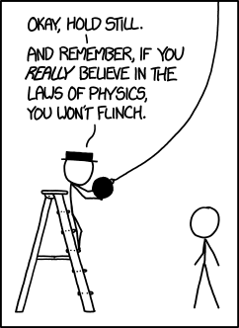
Discussion
Female made gains in conceptual understanding (FCI) compared with Male
Male showed greater interest in the assignment pre to post
Female showed improvements in sense making and applying a conceptual understanding
Female seemed to be more engaged with the assignment..
https://xkcd.com

Slide 16

Implications & Future work
So far the findings suggest that given a choice of context students are more engaged and interested with the physics and show growth in understanding the concepts. Choice of contexts seemed to help female and male students. Male students also showed a variety of gains in interests and attitudes toward physics.
Finish writing my dissertation
Still need to analyze:
  Role of teacher examples used
  The relationship between student extracurricular interests and performance
  Influence of time-on-task, first choice, persistence
  Look at the growth due to choice

Slide 17
Thank you!
This study was made possible with the help of The North Carolina State University Physics Department.
Thank you to AAPT for funding to attend this conference.
If you would like a copy of the conference paper, please write
  Sam Wheeler
  srwheele@ncsu.edu

Slide 18
References
Alozie, N. M., Moje, E. B., & Krajcik, J. S. (2010). An analysis of the supports and constraints for scientific discussion in high school project-based science. Science Education, 94(3), 395-427. doi: 10.1002/sce.20365
American Physical Society. (2012). Fraction of bachelor degrees in STEM disciplines earned by women 1966-2009. from http://www.aps.org/programs/education/statistics/womenstem.cfm
Blickenstaff, J. C. (2005). Women and science careers: leaky pipeline or gender filter? Gender & Education, 17(4), 369-386. doi: 10.1080/09540250500145072
Gibson, Cook, E., & Newing, A. (2006). Teaching Medical Physics. Physics Education, 41(4), 301.
Heilbronner, N. N. (2013). The STEM Pathway for Women: What Has Changed? Gifted Child Quarterly, 57(1), 16. doi: 10.1177/0016986212460085
Hoffmann, L. (2002). Promoting Female' interest and achievement in physics classes for beginners. Learning and Instruction, 12(4), 447-465. doi: http://dx.doi.org/10.1016/S0959-4752(01)00010-X
McCullough, L. (2004). Gender, Context, and Physics Assessment. Journal of International Women's Studies, 5(4), 20-30. doi: http://vc.bridgew.edu/jiws/vol5/iss4/2
McNeely, C. L., & Vlaicu, S. (2010). Exploring Institutional Hiring Trends of Women in the U.S. STEM Professoriate. Review of Policy Research, 27(6), 781-793. doi: 10.1111/j.1541-1338.2010.00471.x
Mulhall, P. a. R. G. (2012). Views About Learning Physics Held by Physics Teachers with Differing Approaches to Teaching Physics. Journal of Science Teacher Education, 23(5), 429-449 doi: 10.1007/s10972-012-9291-2
National_Research_Council. (2013). Adapting to a Changing World--Challenges and Opportunities in Undergraduate Physics Education. Washington, DC: The National Academies Press.

